Slide 1
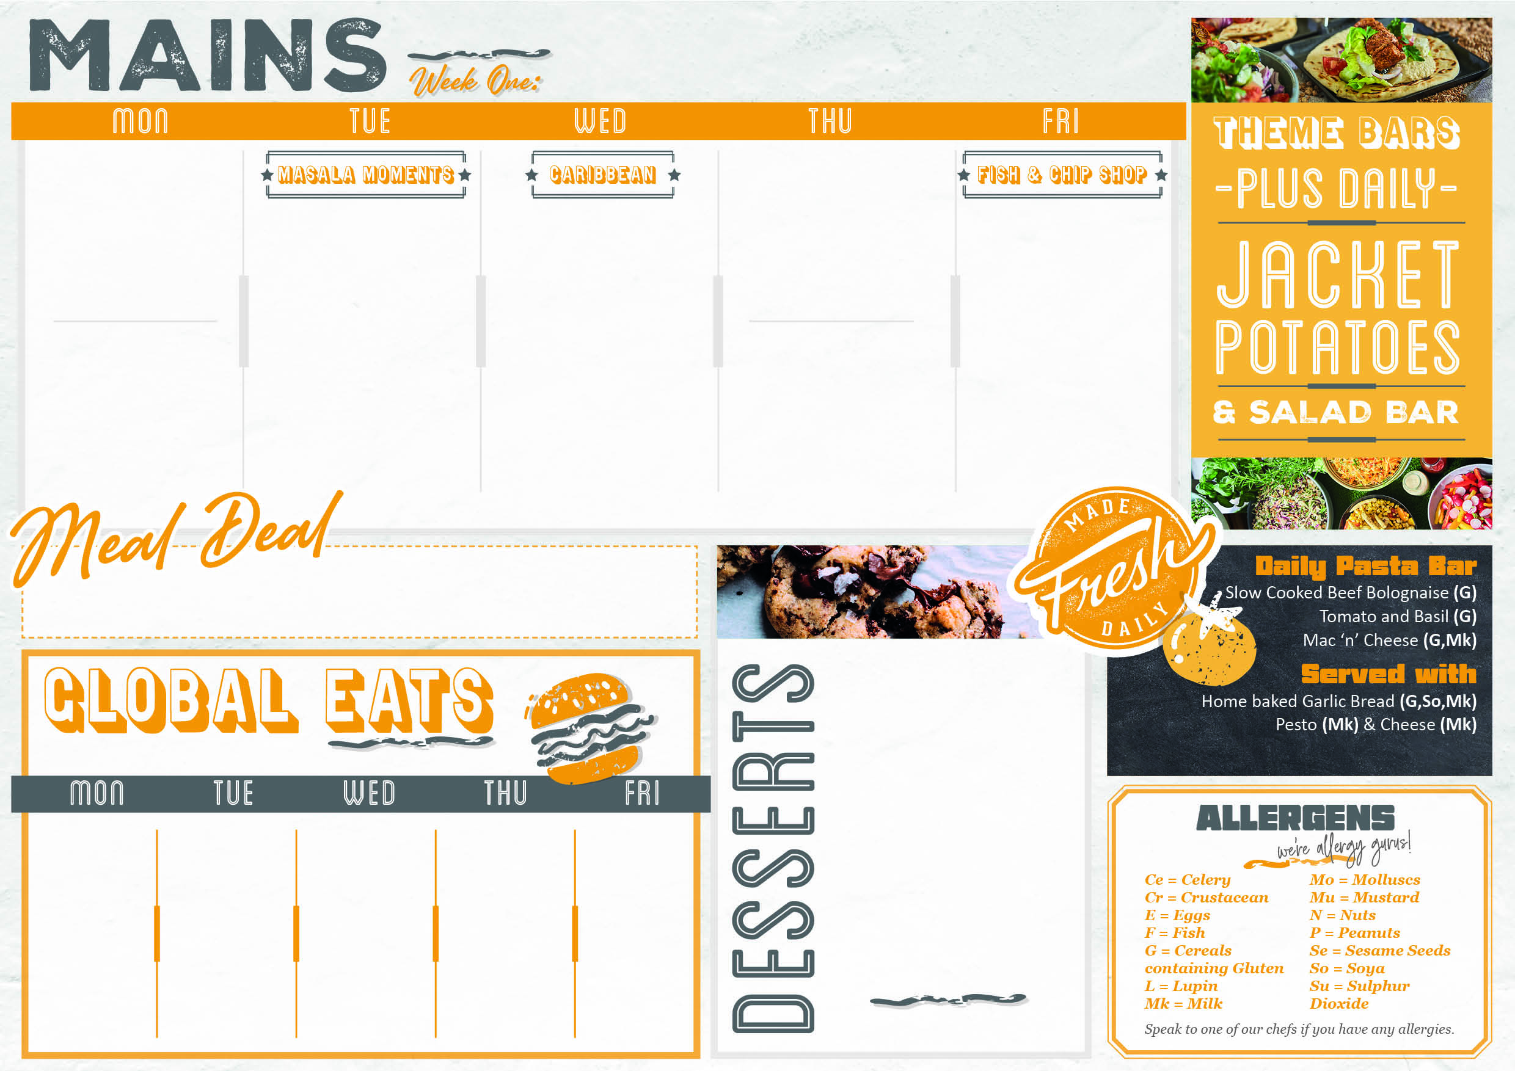
From £2.35
2/9/24 ,7/10/24,4/11/24,2/12/24
Greek Garlic Lemon, Thyme Chicken and Potato Tray Bake served with Broccoli | Chicken Jalfrezi (G) Roasted Aubergine, Tofu and Tomato Curry (G,So,Mk) Lentil and Cauliflower Dahl (G) Pilau Rice Raita (Mk) Mango Chutney Extra Naan bread (G) Onion Bhaji (G) | Sticky Jerk Chicken with Pineapple Salsa (Su) Caribbean Butternut Squash and Black Bean Stew Coconut Rice and Peas (Su) Mango and Pineapple Slaw (G,So) | Butchers Pork Sausages with Gravy (G,Su) Onion Chutney (Su,So,Mu,L) Carrots Broccoli Creamy Mashed Potato | Battered Fish Fillet (G,F) Fish finger dogs (G,F) Cheese and Tomato pizza (G,Mk) Chips Garden Peas Mushy Peas Baked Bean Curry Sauce Pickled Onions, buttered rolls, Pickled Gherkins, Chunky Tartare sauce and lemon
Cajun, Lime, Coriander Tofu and Potato Tray Bake served with Broccoli |  |  | Vegetarian Sausages with Roast Gravy (G,Ce) Onion Chutney (Su,So,Mu,L) Carrots Broccoli Creamy Mashed Potato
Only £2.70
Check out what’s on offer today, available for free school meals!
MONDAY
Chocolate Sponge and Chocolate Sauce (G,So,Mk,E)
TUESDAY
Winter Berry Cheesecake
(G,Mk,E)
WEDNESDAY
Raspberry Jam and Coconut Sponge
(G,Su,So,Mk,E)
THURSDAY
Cornflake Tart and custard
(G,Mk)
FRIDAY
Apple and Mixed Berry Crumble
and Custard (G,So,Mk,E)
From £2.30
From £2.50
Cumberland jumbo sausage hot dog with corn chips (Su,G) | Stir Fry Noodles with Teriyaki Chicken (G,E) | Mozzarella cheese tomato and oregano Panini (G,Mk) | Potato wedges topped with maple and sweet chilli chicken | Bolognaise pasta bake with garlic bread (G,Mk)
From £1.35

Slide 2

From £2.35
9/9/24 , 30/9/24 , 4/11/24, 2/12/24
Chilli Beef con Carne with Steamed Rice served with Sweetcorn and Peppers | Spicy Chicken Burger in a Sesame Bun (G,Se,Mu) Falafel Burger in a Sesame Bun (G,Se) Add Mayonnaise (E) Shredded Iceberg Fried Onions Ketchup Sweetcorn BBQ Beans (Su,So,G,Ce) Baked Potato Wedges | Thyme Roast Chicken with Roast Gravy VEGAN Beetroot & Squash Wellington (G,So) Sage & Onion Stuffing Balls (G) Roast Potatoes Roast Cauliflower Steamed Leeks and Peas Extras Yorkshire Pudding (G,Mk,E) | Slow Cooked Beef Lasagne Topped with Mozzarella (G,Mk,E) Chef Salad Coleslaw (E) Extra Focaccia Fingers (G) | Battered Fish Fillet (G,F) Jumbo Sausage Roll (G,Su,So,Mk) Sausage Dogs (G,Su,Se,Mu,E) Baked Mac and Cheese with Crunchy Topping (G,MSo,Mk) Chips Garden Peas Mushy Peas Baked Bean Spicy Curry Sauce (Mk) Chunky Tartare Sauce (E) Ketchup and Lemon
Vegan Chilli with Steamed Rice, Crushed Nachos Extras Sour Cream (Mk) and Nachos served with Sweetcorn and Peppers |  |  | Mediterranean Vegetable Lasagne Topped with Mozzarella (G,Mk,E) Chef Salad Coleslaw (E) Extra Focaccia Fingers (G)
Only £2.70
Check out what’s on offer today, available for free school meals!
MONDAY
Sticky Lemon Sponge
with Custard (G,So,Mk,E)
TUESDAY
Rice Pudding with
Raspberry Sauce (Mk)
WEDNESDAY
Dutch Apple Caramel Tart
with Custard (G,So,Mk,E)
THURSDAY
Pear and Apricot Crumble
with Custard (G,So,Mk,E)
FRIDAY
Carrot Cake (G,Mk,E)
From £2.30
From £2.50
Cauliflower Keralan Curry with Brown Rice (G) | Thai Pork Noodles with Sweet Chilli (G,E) | Stromboli cheese and tomato pizza (G,Mk) | Tandoori Chicken in folded naan bread with Coriander Salad (G,Mk,E) | Margarita Pizza (G,Mk)
From £1.35

Slide 3

From £2.35
16/9/24 , 14/10/24 , 18/11/24 , 16/12/24
Spanish style Pork with Chorizo, chick peas and potatoes, served with green beans | Tex Mex Turkey Enchiladas (G,Mu,Mk) Chick pea and Vegetable Moqueta (Su,Mu) Blackbean, Sweetcorn and Coriander Rice Seared Greens Extra Cheesy Cornbread (Mk,E) | Thai Green Chicken Curry Butternut Squash Thai Curry (Mk,F) Coconut Rice (Su) Thai Ginger Beansprout Salad Extra Spring Roll with Sweet Chilli Sauce (G,So,Mk,E,CE) Prawn Cracker (Cr) | Roast Pork with sage and onion stuffing and Yorkshire pudding with Broccoli and green beans Roast Potato (G,Mk,E) | Battered Fish Fillet (G,F) Sausage dogs (G,Su,Se,Mu,E) Jumbo Sausage Roll (G,Su,So,Mk) Focaccia Pizza (G,Mk) Chips Garden Peas Mushy Peas Baked Bean Spicy Curry Sauce (Mk) Chunky Tartare sauce (E) Ketchup and lemon
Spanish style Tofu with chick peas and potatoes, served with green beans |  |  | Creamy Vegetable and Sweetcorn Puff Pastry with Broccoli and Green Beans Roast Potatoes Potato (G,Mk)
Only £2.70
Check out what’s on offer today, available for free school meals!
MONDAY
Lemon Blondie (G,E)
TUESDAY
Banoffee Pie (G,So,Mk)
WEDNESDAY
Chocolate Brownie (G,E)
THURSDAY
Jamaican Ginger cake
with Custard (G,So,Mk,E)
FRIDAY
Apple and Rhubarb Crumble
with Custard (G,So,Mk,E)
From £2.30
From £2.50
Mediterranean Chicken in Flat Bread with potato wedges and Garlic mayonnaise (G,Su,Mk,E) | Jerk rubbed Chicken Leg with Spicy Rice | piri piri chicken in a tortilla with Mexican salad (G,Mk) | Chilli Dog with grated mozzarella and crushed tortillas (G,Mk) | Cheese and Tomato pasta bake with garlic bread (G,Mk)
From £1.35

Slide 4

From £2.35
23/9/24 ,28/10/24, 25/11/24
Creamy Honey and Mustard Pork with Leeks (G,Mu,Mk) Savoury Rice Sweetcorn | Pomegranate and Harissa Chicken Traybake (So,Mk) Spicy Aubergine and Bean Stew with Coriander and Mint (G) Lemon and Herb Couscous (G,So,Mu) Steamed Broccoli Grilled Pitta Breads (G) Extra Hummus (G,Se,Mk) | Roast Turkey Cranberry Sauce Roast Gravy leek and cheese Crown (G,Mk) Sage & Onion Stuffing Balls (G) Roast Potatoes Steamed Duo of Cabbages Roast Carrots Extras Yorkshire Pudding (G,Mk,E) | Creamy Mac and Cheese with BBQ Chicken Thighs and Chefs Salad Extra Garlic Bread | Battered Fish Fillet (G,F) Jumbo Sausage Roll (G,Su,So,Mk) Sausage Dogs (G,Su,Se,Mu,E) Vegetable Spring Roll with Sweet and Sour Sauce (G,So) Chips Garden Peas Mushy Peas Baked Bean Spicy Curry Sauce (Mk) Chunky Tartare Sauce (E) Ketchup and Lemon
Creamy Honey & Mustard Quorn and Vegetables (G,Mu,Mk,E) Savoury Rice Sweetcorn |  |  | Creamy Mac and Cheese with BBQ Tofu and Spicy beans with Chefs Salad Extra Garlic Bread
Only £2.70
Check out what’s on offer today, available for free school meals!
MONDAY
Sticky Toffee Pudding (G,Su,Mk,E) with Toffee Sauce (Su,Mk
TUESDAY
Roasted Pineapple and Ginger Cake
(G,So,Mk,E)
WEDNESDAY
Banana Cake with Cream Cheese Frosting (G,Mk,E)
THURSDAY
Lemon and Poppy Seed Pudding
(G,So,Mk,E)
FRIDAY
Chocolate pot (Mk)
From £2.30
From £0.00
Loaded nachos with chilli beef sour cream and jalapenos (Mk) | 5 spice chicken noodles with sweet and sour sauce (E,Mk) | Pulled Chicken in a Bun with Chipotle Slaw (G,So,Se,Mu,Lu,E) | Panini melt (G,Mk) | Stone baked chees tomato and oregano pizza (G,Mk)
From £1.35

